Slide 1
A Survey of Hydra Project
北京大学智能计算与感知实验室
Intelligent Computing and Sensing Laboratory, Peking University
Meng Ma
mameng@pku.edu.cn
Oct. 2012

Slide 2
Outline
Overview of Hydra Project
Hydra Architecture
Hydra Managers
Use Case of Hydra
Healthcare
Agriculture

Slide 3
Overview of Hydra Project
The HYDRA project develops middleware for networked embedded systems that allows developers to create ambient intelligence applications utilizing device and sensor networks with the help of OSGi Declarative Service and OWL Ontologies.
OSGi: Open Services Gateway initiative
Wiki: Ambient Intelligent (AmI) refers to electronic environments that are sensitive and responsive to the presence of people.
Source Code: Link Smart 1.1 Modified 2011-11-25
Executable: Link Smart 1.2 Modified 2012-08-28

Slide 4
Overview of Hydra Project
HYDRA project objectives includes:
Development of a middleware based on a Service-oriented Architecture, to which the underlying communication layer is transparent
Design of a generic semantic model-based architecture supporting model-driven development of applications.
Development of a toolkit for developers to develop applications on the middleware.
Design of a business modeling framework for analyzing the business sustainability of the developed applications.

Slide 5
Overview of Hydra Project
HYDRA project focuses in the following research areas:
Embedded and mobile service-oriented architectures for ubiquitous networked devices;
Semantic Model-Driven Architecture for Ambient Intelligence implementation;
Ontology-based knowledge modeling;
Wireless devices and networks with self-* properties (self-diagnosis, self-configuring, self-healing, etc.);
Distributed security and privacy

Slide 6
Overview of Hydra Project
The HYDRA middleware addresses two different types of users:
Developer users, who will use the Hydra middleware to develop their applications,
End-users, who will use Hydra applications developed by the developer users.

Slide 7
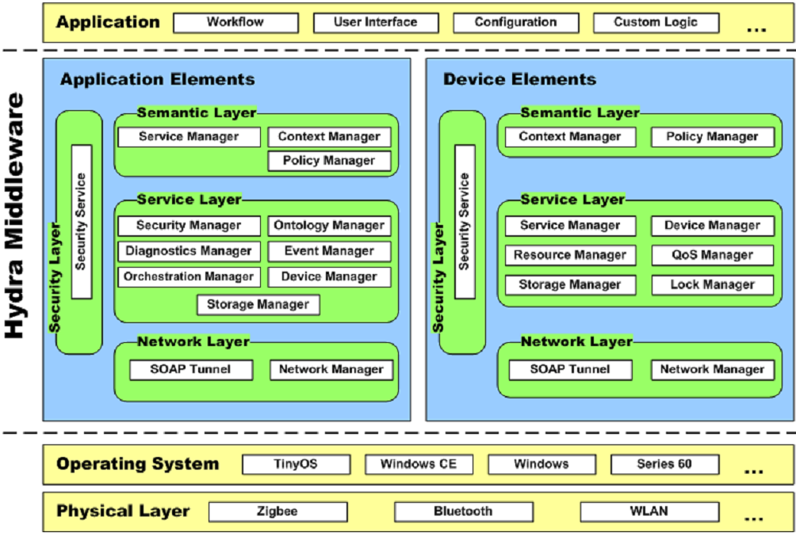
Hydra/LinkSmart (Eisenhauer, M@SECON’09)

Slide 8
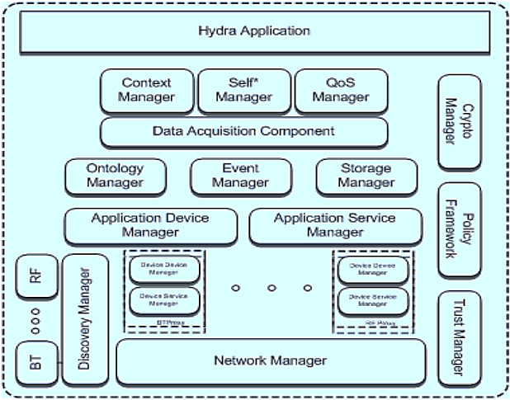
Hydra Architecture

Slide 9
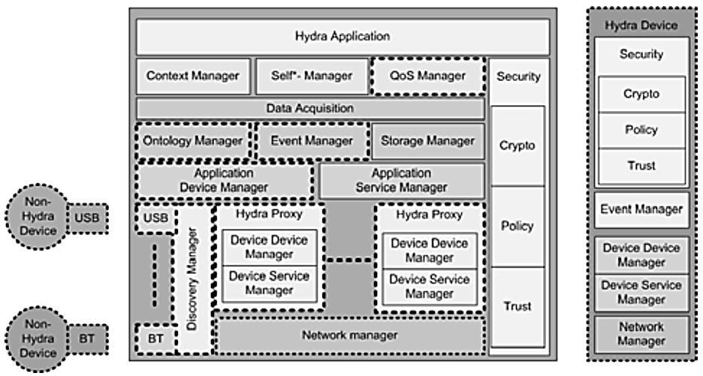
Hydra Architecture

Slide 10
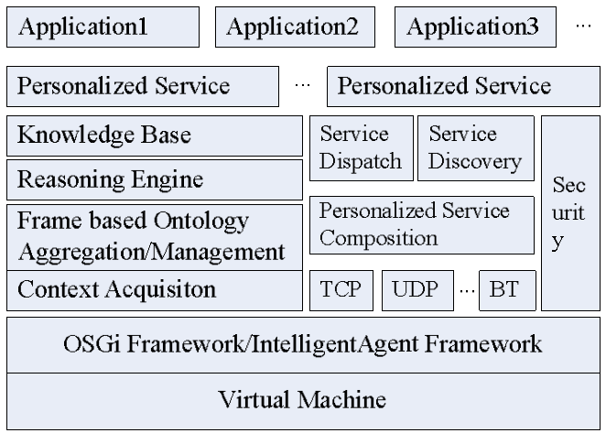
Typical Architecture

Slide 11
Hydra
In Hydra, the overall functional architecture is divided into two parts, namely:
Application Elements(AEs) : AEs are meant to be deployed and run on comparably powerful machines.
Device Elements(DEs) : DEs describe components that are usually deployed inside Hydra-enabled devices where small devices may be involved.

Slide 12
Hydra Managers
Network Manager: which handles the lower networking issues as part of the network layer
Context Manager: for the definition of conditions triggering an alert.
Event Manager: for creating events based on measured data
Device Manager: which offers the possibility of finding devices that support different network protocols
Ontology Manager: which permits one to describe devices on a semantic level
Diagnostics Manager: which is used to monitor the system’s conditions, error detection and logging

Slide 13
Hydra Managers
Secuirty: Hydra incorporates in its design high-level security, trust and privacy concerns.
QoS Manager: QoS Manager is a service component that applies a semantic service selection algorithm to support the decision for selecting best-suitable service.

Slide 14
Ontology Managers
Reasoner: The reasoner module is responsible for reasoning about devices and their status and provides inferencing mechanisms for instance to conclude what type of device has entered the network.
Query module: The query module allows for retrieving information regarding devices and their capabilities.
Update module: The update module allows entering of new information, deletion and changes to the ontology at both design time and run time.
Versioning: The versioning module is responsible for managing different version of the ontology. This includes different versions of devices and services.
Parse & Annotate: The parse & annotate modules is responsible for automatically update the ontology with new device types.

Slide 15
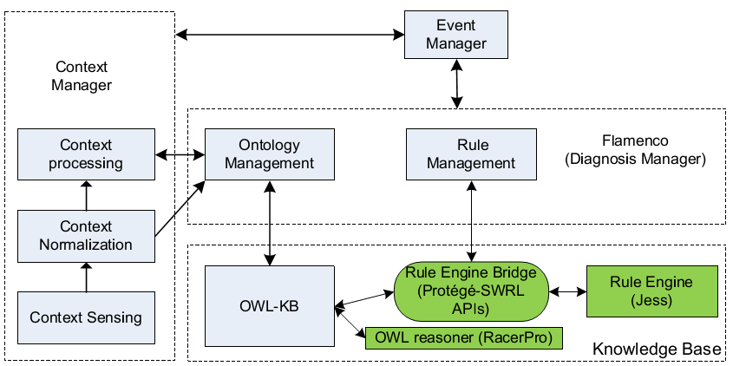
Context/Event Manager

Slide 16
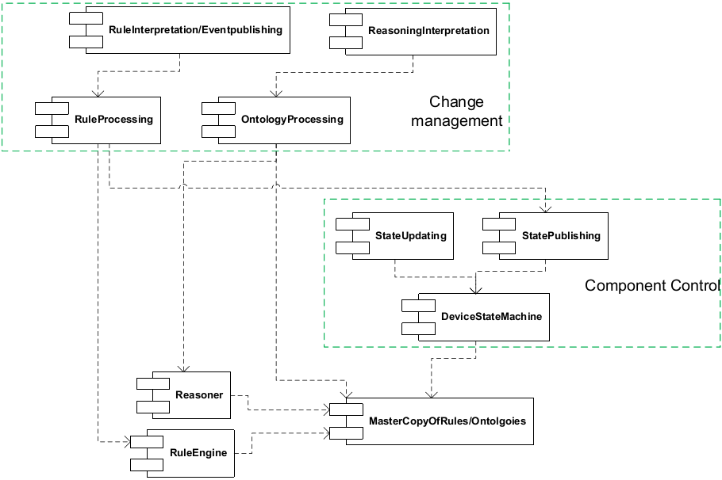
Diagnostics Managers
Rule/Ontology Processing
State Processing

Slide 17
Use Case of Hydra
The implemented HYDRA middleware and toolkit is validated in real end-user scenarios in three different user domains:
a) Facility management (home automation)
b) Healthcare
c) Agriculture

Slide 18
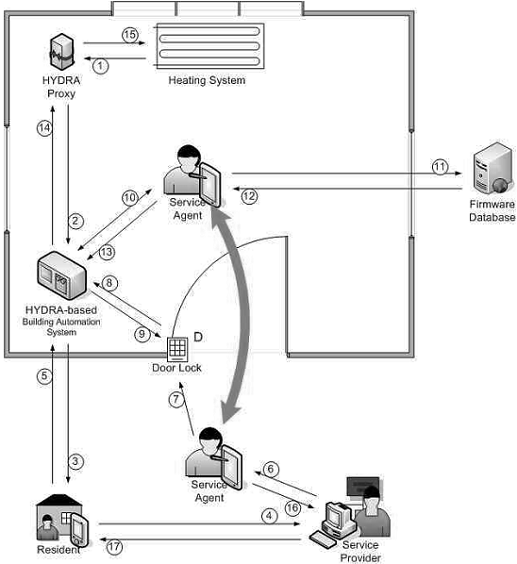
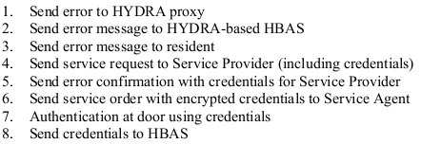
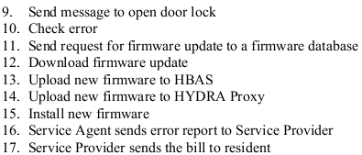
Use Case: Building Automation

Slide 19
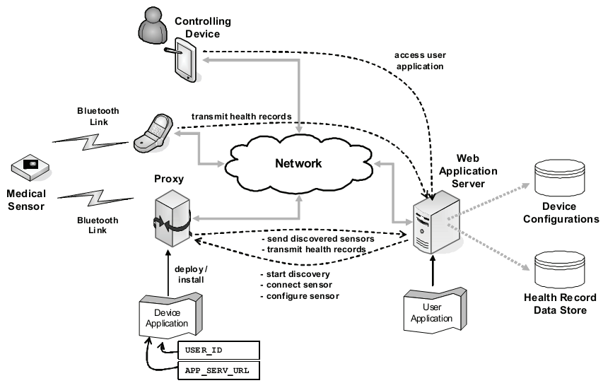
Use Case: Healthcare

Slide 20
Thank You.

